Slide 1


SPAM Project Report
By:
Roshan Kumar Verma

Slide 2
Introduction
Spam Detector is used to detect unwanted, malicious and virus infected texts and helps to separate them from the non-spam texts. It uses a binary type of classification containing the labels such as ‘ham’ (non-spam) and spam. Application of this can be seen in Google Mail (GMAIL) where it segregates the spam emails in order to prevent them from getting into the user’s inbox.
These information are Gathered from Different Sources:- Spam Email , become a big trouble over the internet. Spam is waste of time, storage space and communication bandwidth. The problem of spam e-mail has been increasing for years. In recent statistics, 40% of all emails are spam which about 15.4 billion email per day and that cost internet users about $355 million per year Knowledge engineering and machine learning are the two general approaches used in e-mail filtering In knowledge engineering approach a set of rules has to be specified according to which emails are categorized as spam or ham. Machine learning approach is more efficient than knowledge engineering approach; it does not require specifying any rules . Instead, a set of training samples, these samples is a set of pre classified e-mail messages. A specific algorithm is then used to learn the classification rules from these e-mail messages. Machine learning approach has been widely studied and there are lots of algorithms can be used in e-mail filtering. They include Naive Bayes, support vector machines, Neural Networks, K-nearest neighbour, Rough sets and the artificial immune system.

Slide 3
Problem Statement
The SMS Spam Collection is a set of SMS tagged messages that have been collected for SMS Spam research. It contains one set of SMS messages in English of 5,574 messages, tagged according being ham (legitimate) or spam.
A collection of 5573 rows SMS spam messages was manually extracted from the Grumble text Web site. This is a UK forum in which cell phone users make public claims about SMS spam messages, most of them without reporting the very spam message received. The identification of the text of spam messages in the claims is a very hard and time-consuming task, and it involved carefully scanning hundreds of web pages.

Slide 4

Data Sources and their formats
A subset of 3,375 SMS randomly chosen ham messages of the NUS SMS Corpus (NSC), which is a dataset of about 10,000 legitimate messages collected for research at the Department of Computer Science at the National University of Singapore. The messages largely originate from Singaporeans and mostly from students attending the University. These messages were collected from volunteers who were made aware that their contributions were going to be made publicly available.
The files contain one message per line. Each line is composed by two columns: v1 contains the label (ham or spam) and v2 contains the raw text. This corpus has been collected from free or free for research sources at the Internet.
Below is the shape of the data which is provided to us .

Slide 5
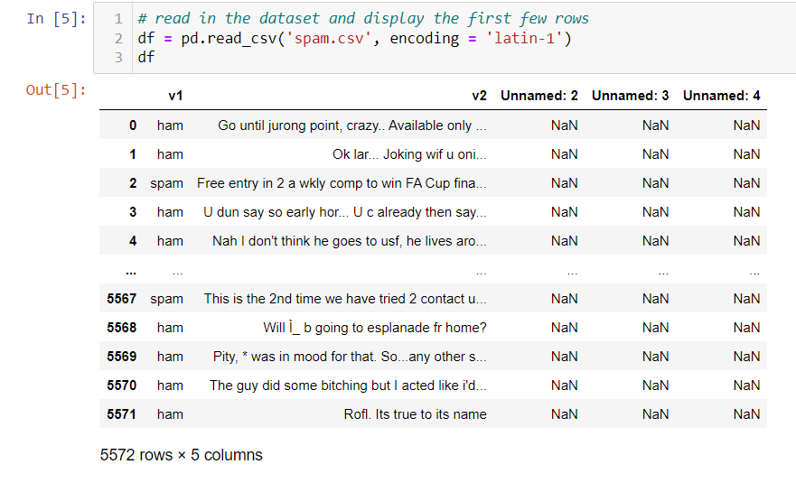
Data Description
A collection of 5573 rows SMS spam messages was manually extracted from the Grumble text Web site. This is a UK forum in which cell phone users make public claims about SMS spam messages, most of them without reporting the very spam message received. The identification of the text of spam messages in the claims is a very hard and time-consuming task, and it involved carefully scanning hundreds of web pages.

Slide 6

Data Visualizations

Slide 7
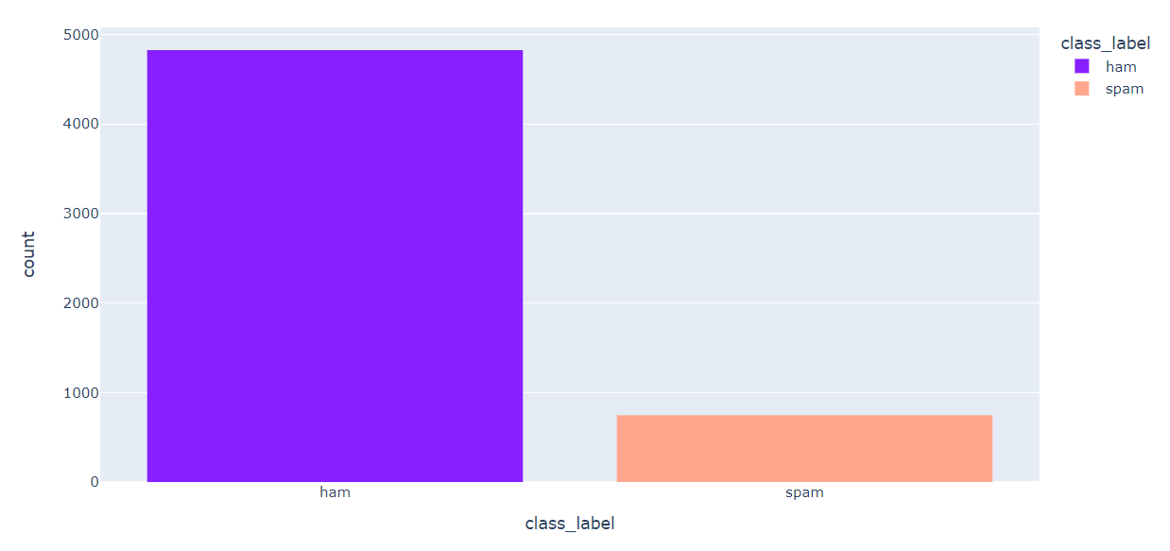
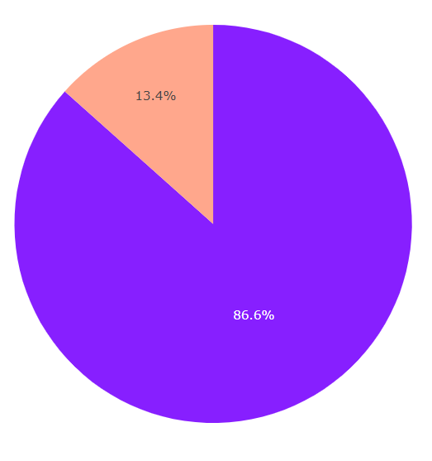
univariate analysis
87%ham and 13%spam messages present in the dataset

Slide 8
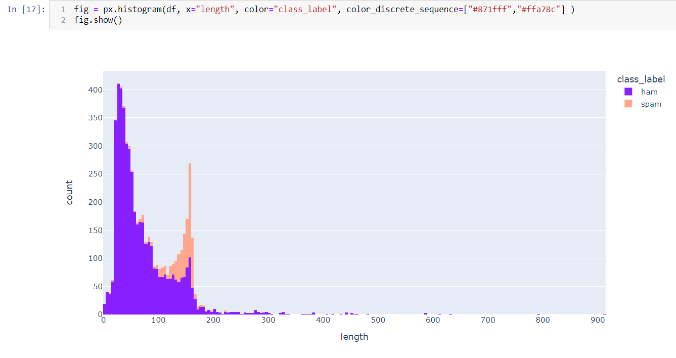
univariate analysis
Spam messages found to lengthier than ham messages

Slide 9
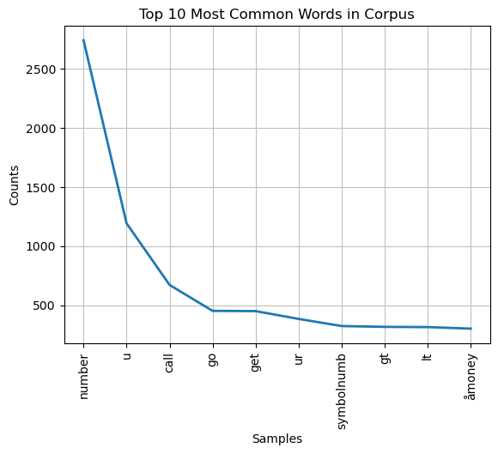
Analysis using Words with NLP

Slide 10
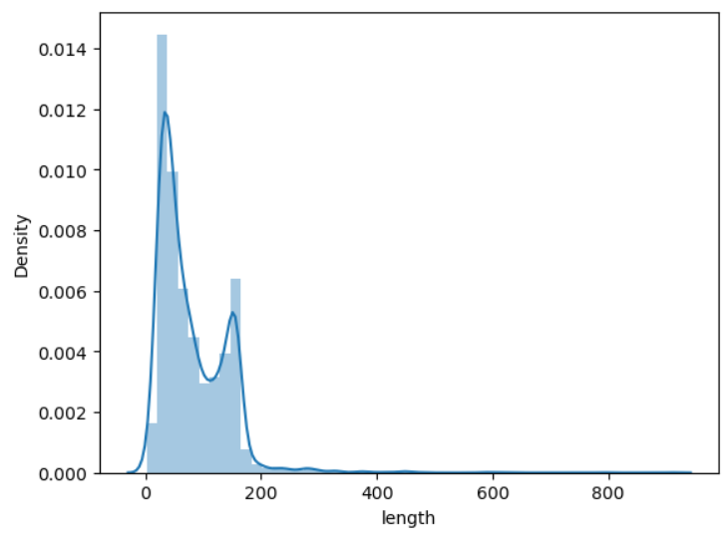
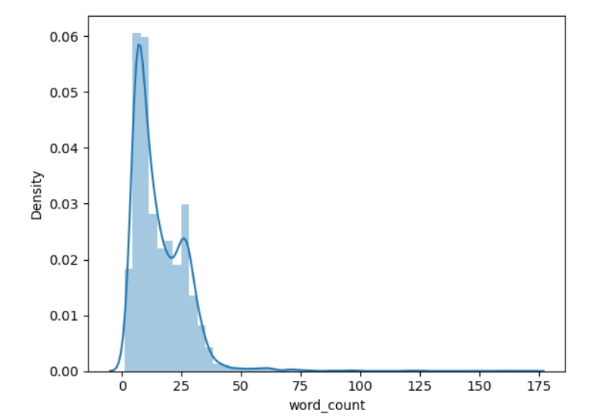
Analysis vs Density with NLP

Slide 11
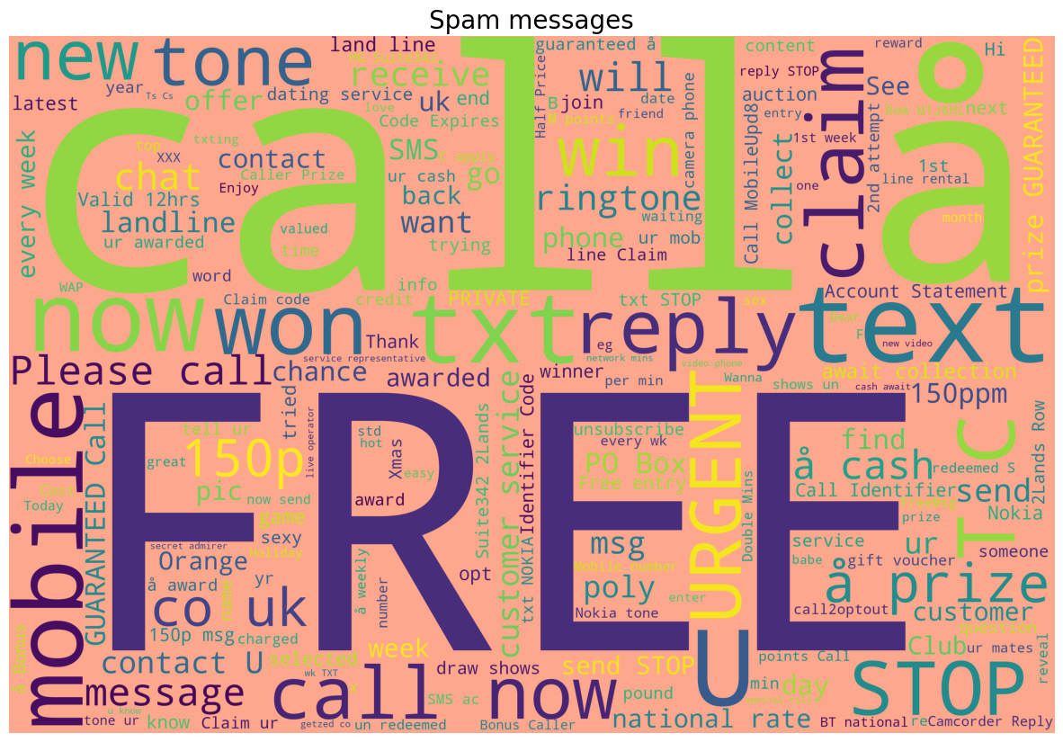
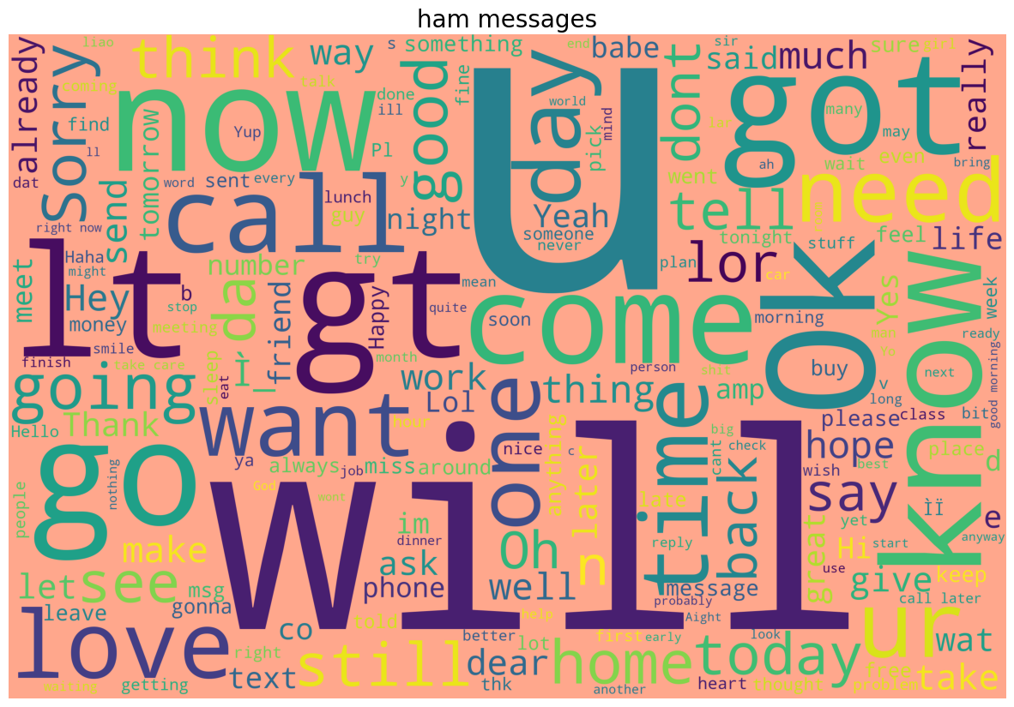
Displaying the Word-cloud
From the above wordclouds, we can see that the large texts have more weightage in their respective type of comments whereas small texts have the lesser weightages

Slide 12
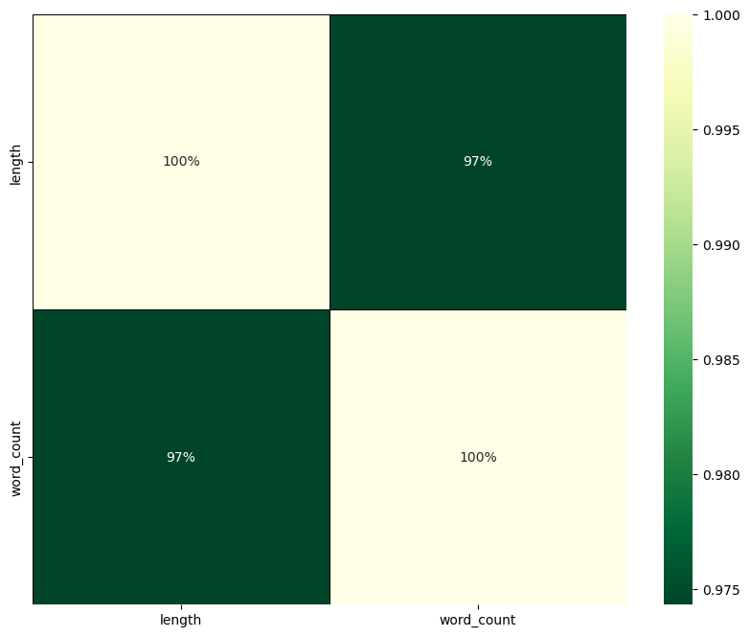
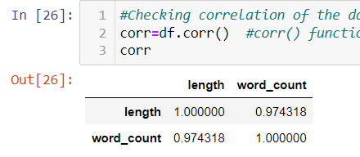
Observing Correlation
There is multi collinearity between Number of sentences, words and characters.
All are having some correlation but let's check the same in value mode through heat-map.

Slide 13

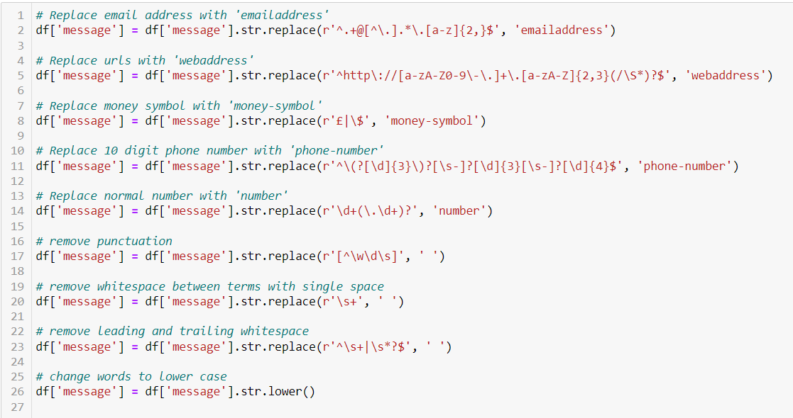
Data pre-processing

Slide 14
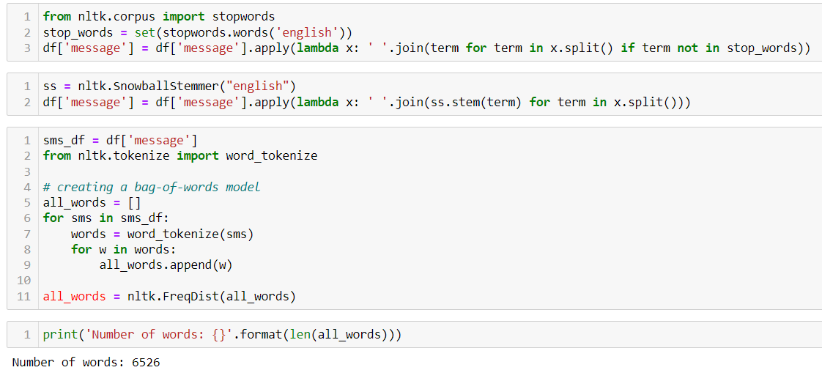
Pre-processing using NLP

Slide 15
Model/s Development and Evaluation

Slide 16

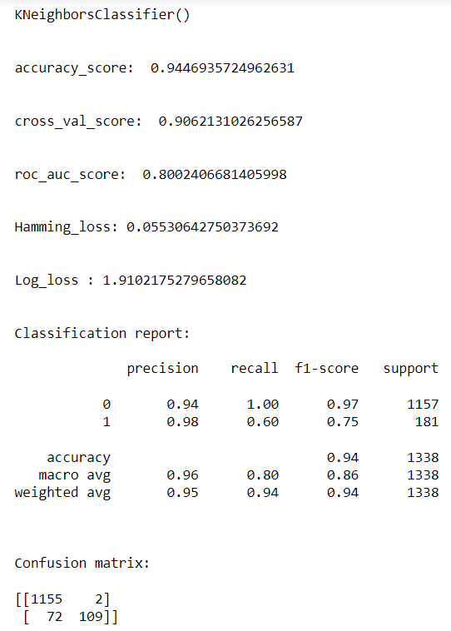
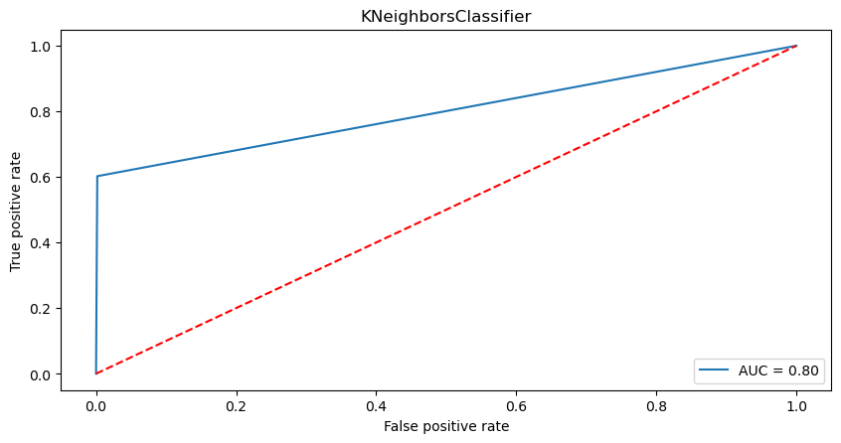
K Neighbors Classifier

Slide 17
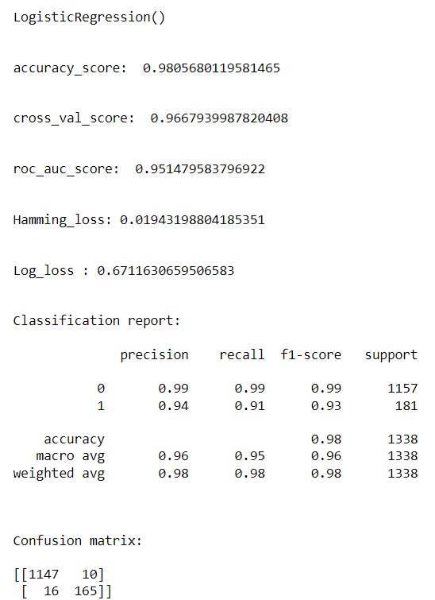
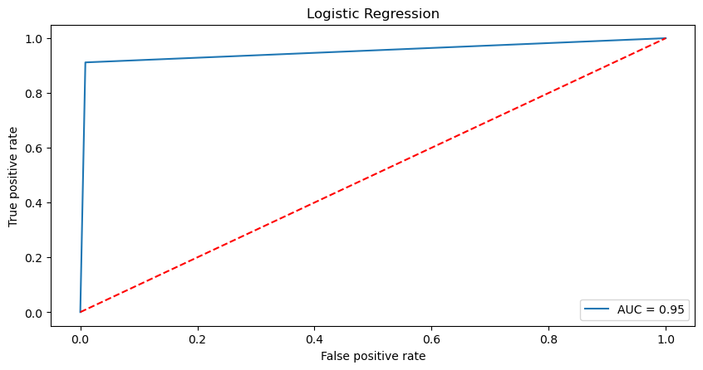
Logistic Regression

Slide 18
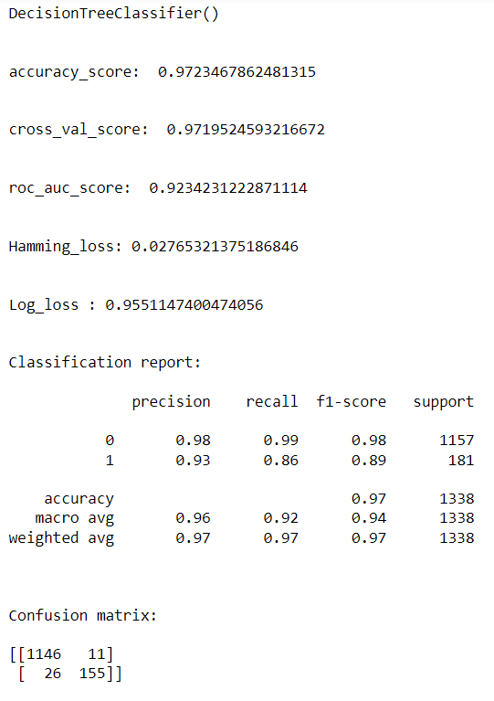
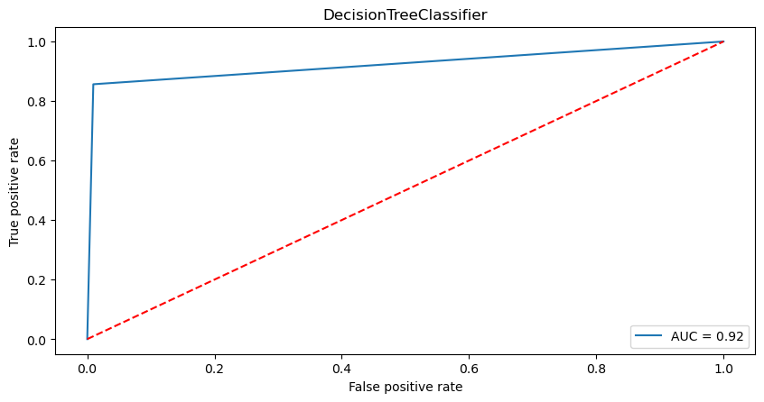
Decision Tree Classifier

Slide 19
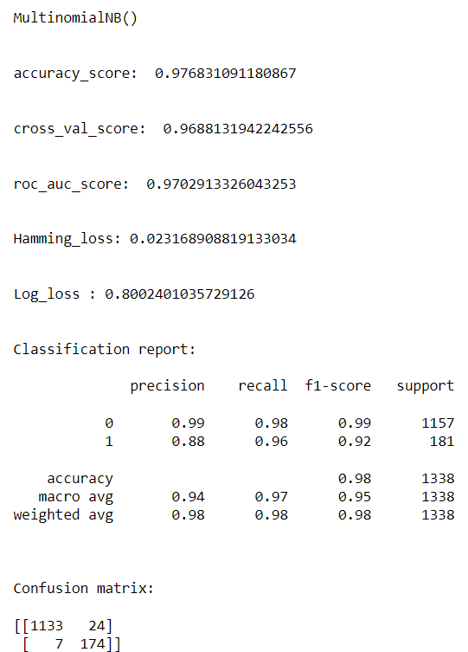

Multinomial NB

Slide 20
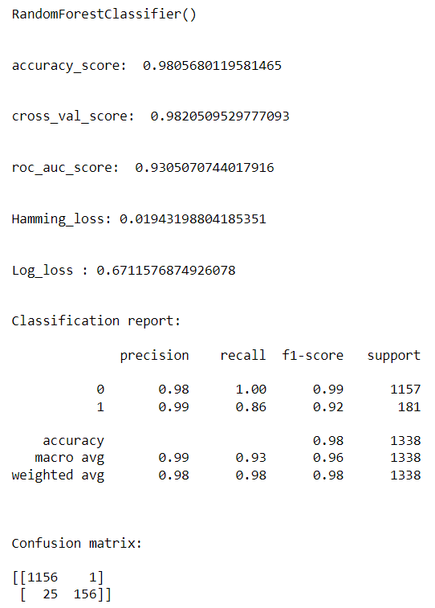
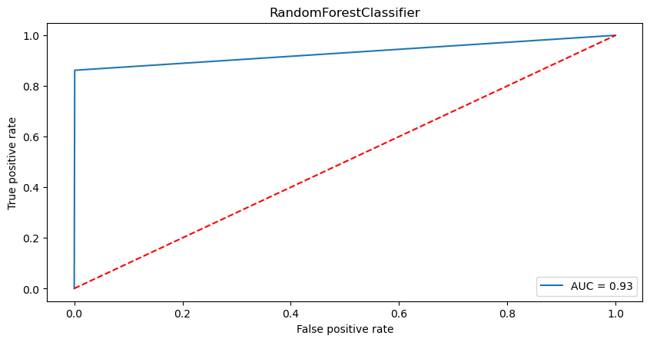
Random Forest Classifier

Slide 21
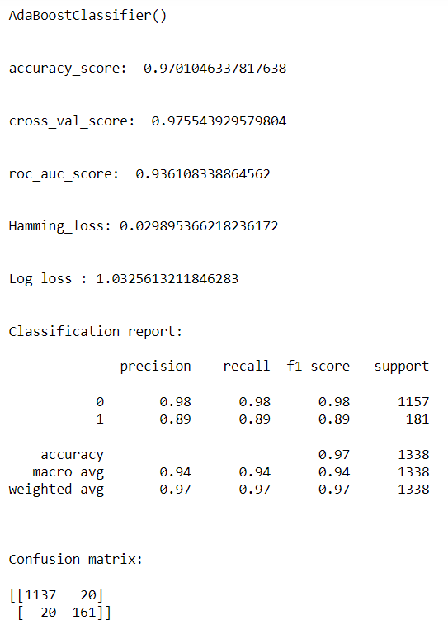
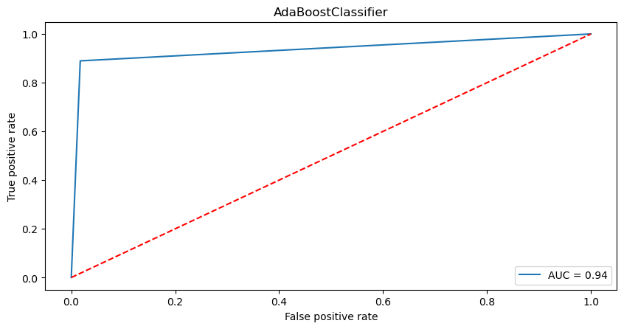
AdaBoostClassifier

Slide 22
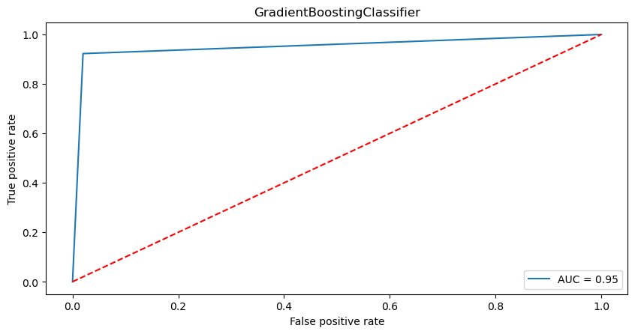
Gradient Boosting Classifier

Slide 23
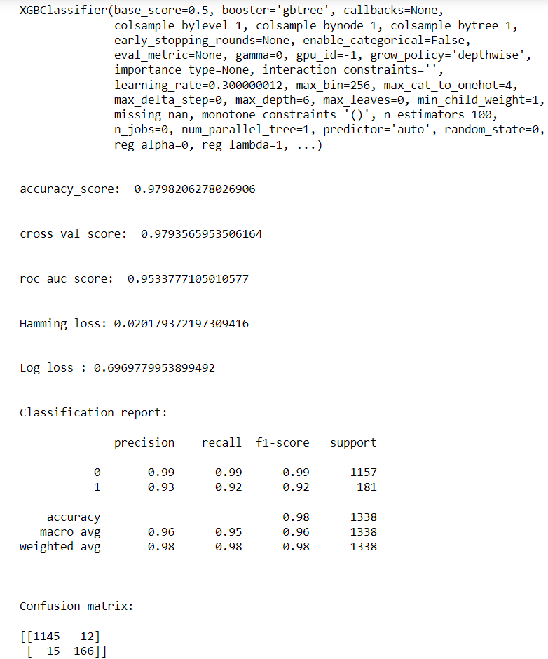

XGB Classifier

Slide 24
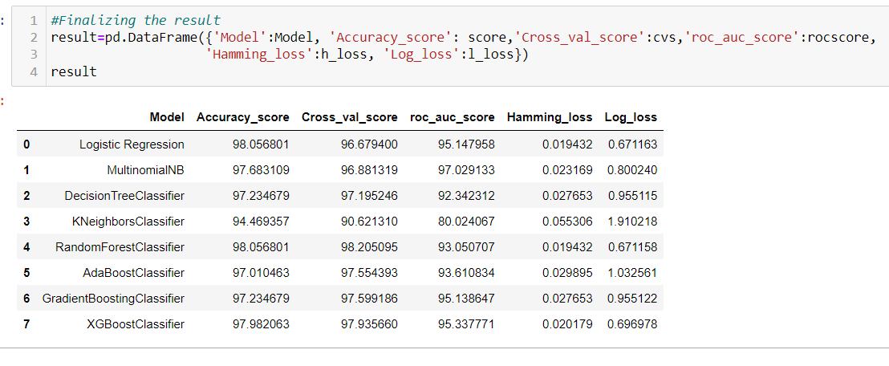
Interpretation of the Results
Logistic Regression and Random Forest Classifier showed the best accuracy (98.25%). After running the for loop of classification algorithms and the required metrics, we can see that the best 2 performing algorithms are Random_Forest_Classifier because the loss values are less and their scores are the best among all. Now, we will try Hyperparameter Tuning to find out the best parameters and using them to improve the scores and metrics values.

Slide 25
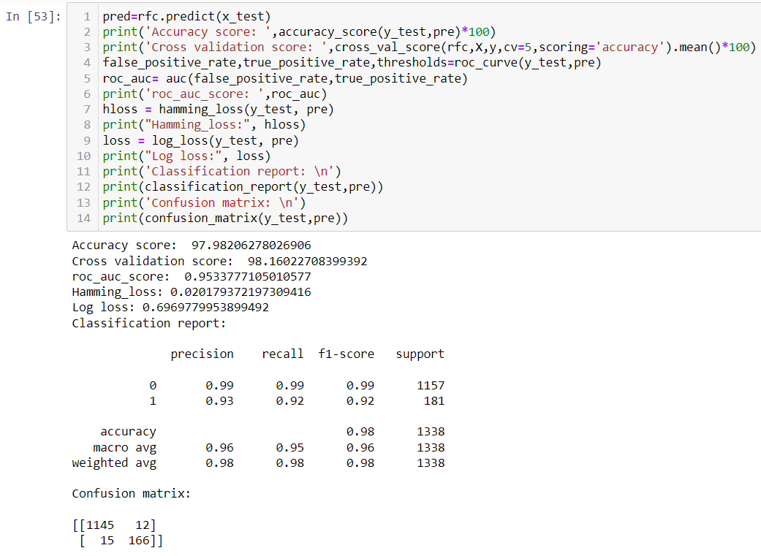
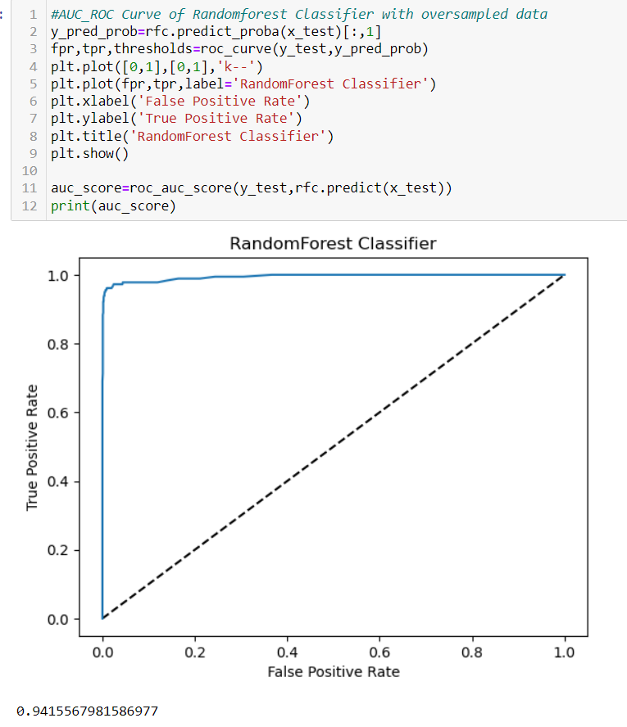
Hyper-parameter Tuning

Slide 26
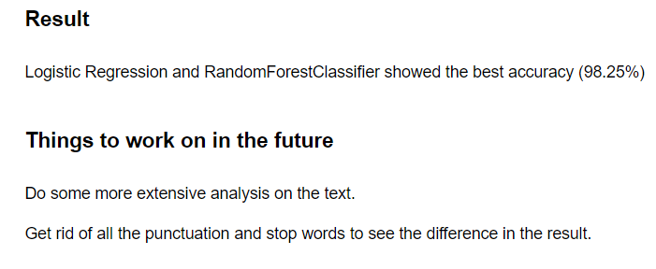
Conclusion
We converted all the text to lower case and made a bag of words. Counted the frequency of each word and chose 3,000 most frequent word Make a feature set that is simply a sequence of True, False based on whether the data set contains word in "frequent word" set or not.

Slide 27

Slide title 29

